Slide 1
Coursera capstone project
Finding the right neighborhood in Brooklyn

Slide 2
Goal: find the perfect location to live in brooklyn
When moving to a new city, one faces several challenges like selecting the perfect location to stay and which neighborhoods are good for living
What neighborhoods are similar and what kind of venues can be found in each location in Brooklyn?
This project intends to cluster the neighborhoods in Brooklyn according to their characteristics in order to give the best recommendation
It can also be used in the future by any other person interested in moving to a new city without having enough information about the different neighborhoods

Slide 3
Data acqusition: two different data sources Will be used
Dataset containing information about the different neighborhoods that exist in each borough in New York as well as the the latitude and longitude coordinates of each neighborhood
https://geo.nyu.edu/catalog/nyu_2451_34572
Information of the different venues that exist in each neighborhood
Foursquare API

Slide 4
Methodology: After the data preparation K-means clustering is used to obtain the groups of similar areas
Data Preparation:
Transform the dataset into a pandas dataframe and complement it with the information of the longitude and latitude of the neighborhoods using geopy library
Filter only the neighborhoods in Brooklyn
Complement this data with the information about the existing venues in each area using Foursquare API
Analyze the unique values for the venues in each neighborhoods and preparation of the clustering process
K-Means Clustering:
Fit K-Means
Examine the clusters and provide a recommendation according to the preferences of each client

Slide 5
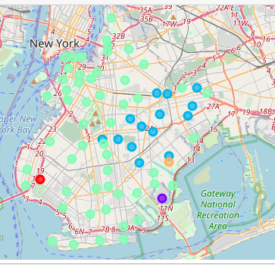
RESULTS: five clusters of Neighbor-hoods with different characteristics

Slide 6
Now anyone can choose between the defined clusters when looking for the perfect neighborhood

